Slide 1



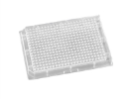
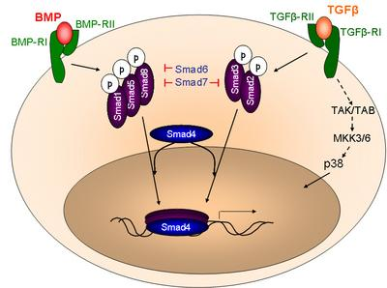
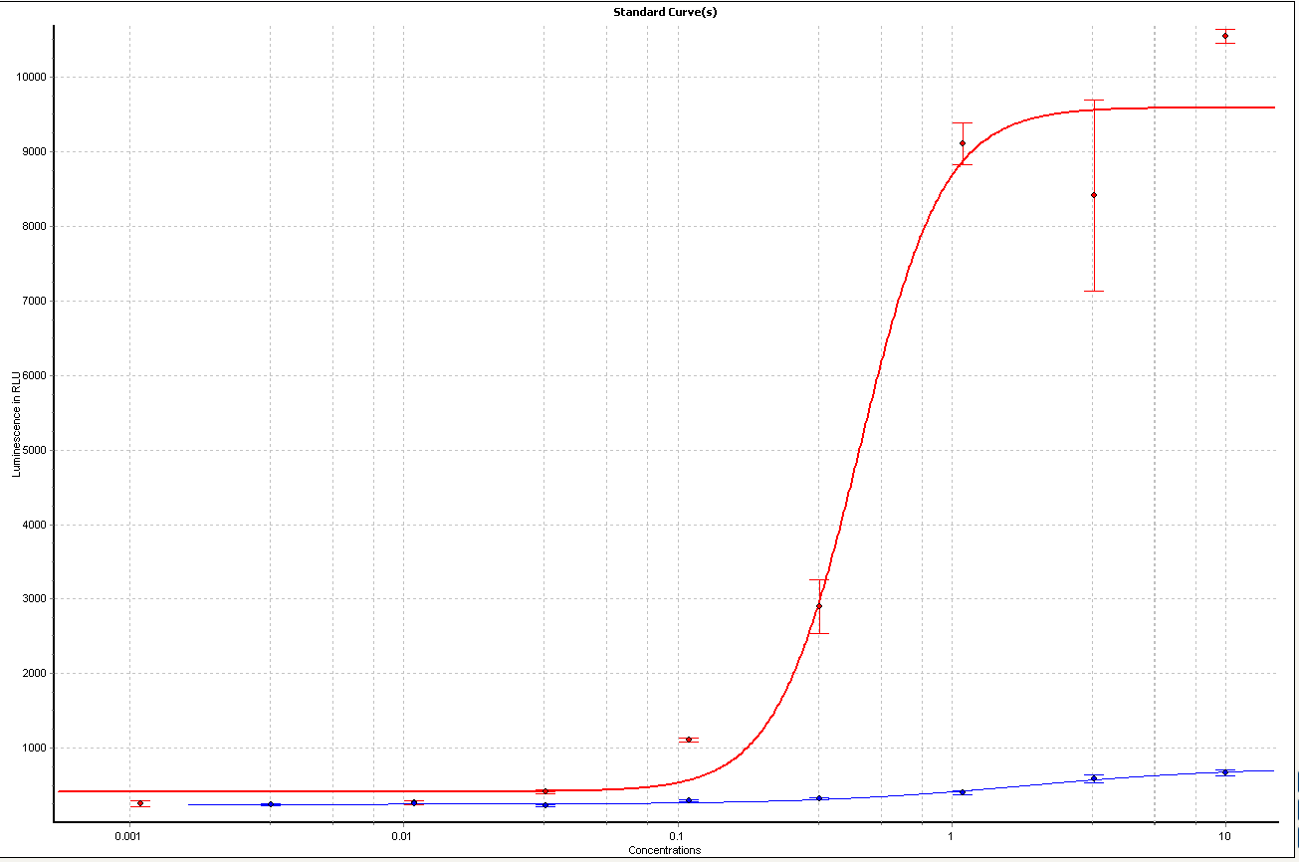
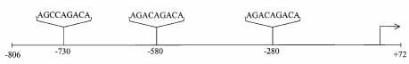
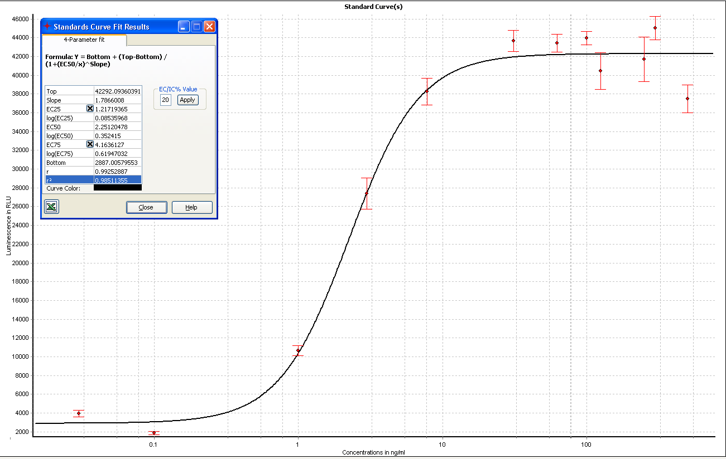
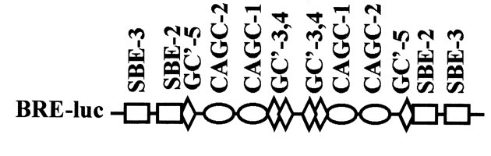
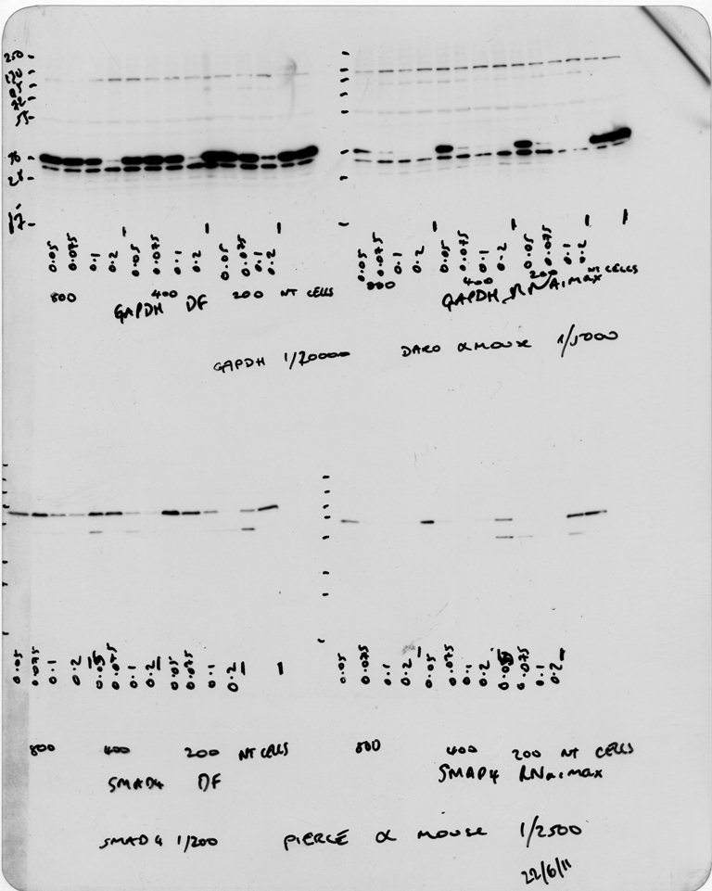
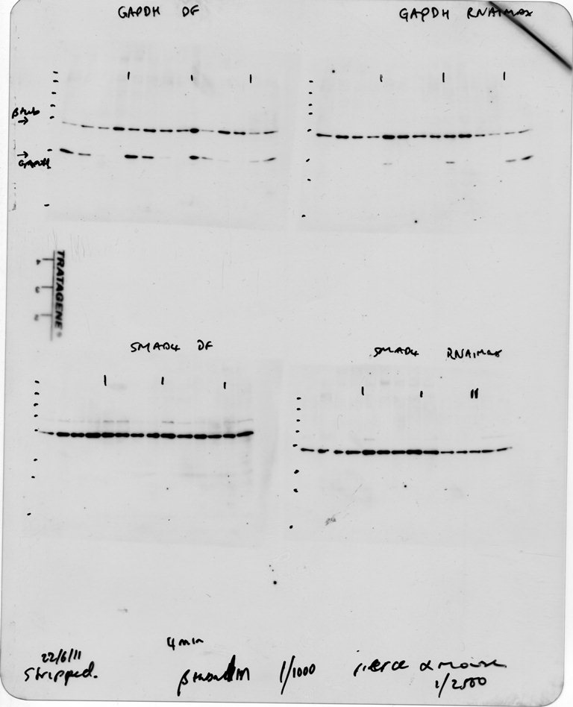
High Throughput Screening To Identify Effectors Of The
Bone Morphogenetic Protein Signalling Pathway.
Matthew Benson*, Karen Soegaard*, Angela Lee*, Alison Howarth**, Dilair Banan***, Daniel Ebner**, and Shoumo Bhattacharya*.
*Radcliffe Department of Medicine, Division of Cardiovascular Medicine, University of Oxford
** Target Discovery Institute, University of Oxford
** *High throughput Genomics Facility, WTCHG, University of Oxford
Background
The transforming growth factor β (TGFβ) superfamily of proteins, which includes the Bone morphogenetic protein (BMP) subgroup, encompasses a functionally diverse group of glycosylated, extracellular matrix-associated signalling molecules [1]. Fine control of the BMP-signalling process via an intricate mechanism of antagonists, receptor functional regulation and BMP-target gene methylation is fundamental to a wide variety of cellular processes. Disruption of this control underlies numerous developmental disorders and human diseases including abnormal cardiac development, fibrosis and pulmonary hypertension [2]. Furthermore, maintenance of the fine balance between TGFβ (increases cardiac fibrosis) and BMP (decreases cardiac fibrosis) is highly relevant to myocardial homeostasis [3]. We have developed a high-throughput cell-based assay to identify genes which affect the BMP-signalling pathway.
High-throughput screening protocols
To identify novel effectors of, and putative novel drug targets for BMP signalling, using the BRE-luc C2C12 cell line we performed large scale RNAi cell-based assays (9968 genes) SiRNA inhibitors were chosen from members of the druggable genome or potential drug targets (primarily kinases and GPCRs).
Day One
2500 C2C12 Bre-luc cells in 50ul media (10% FCS)/well
Day Two
Day Three
Day Four
siRNA library in 384 well plates
0.4ul RNAimax in 20ul optimem
1x384 well,
white plate
Media removed,
cells washed in PBS,
steadylite added and
luciferase signal read
1x384
well plate
control siRNAs
20 min incubation then 18ul transferred to new plate
Media removed and replaced with 0.1% FBS media containing BMP4 (3ng/ml)
Repeated in duplicate at
25nM siRNA final conc.
Therapeutic targets in the BMP signalling pathway
The screening data was analysed using CellHTS2 (web-cellhts2.dkfz.de).
653 siRNAs were classified as hits having a B-Score of +/- 3
Development of a TGFβ luciferase reporter C2C12 cell line to assess off-target effects
To confirm that the effects seen on the BRE-luc reporter where A) specific for BMP-signalling and B) not targeting luciferase directly the TGFβ responsive element from the PAI-1 promoter, CAGA12, was cloned into the same plasmid backbone as the BRE-luc reporter. This plasmid was then transfected into C2C12 cells together with a plasmid expressing G418 resistance and a stable cell line was produced by multiple rounds of selection using 800ug/ml G418.
BMP signalling proceeds initially by propeptide cleavage via Furin/PCSK5.
BMP antagonists such as chordin, gremlin, noggin are also activated by propeptide cleavage (TLL-1).
BMP binds to receptors on the cell surface causing dimerisation
Activated BMP receptors phosphorylate SMAD proteins which regulate the potentiation of BMP-signalling via the R-SMADS. Phospho-SMADS bind to SMAD4 and enter the nucleus
The SMAD-complex enters the nucleus and induces gene expression.
Structure of the CAGA12-luc reporter
Adapted from Walsh et al., Trends in Cell Biology, 2010
TGFβ response (uM)
BMP4 response (ng/ml)
BMP response of the C2C12 BRE-luc cell line
Having established an assay to assess non-BMP driven off-target effects, 580 siRNA hits were retested against BRE-luc and CAGA12-luciferase in C2C12 cells.
Of the 580 hits, RNA inhibition of 102 genes caused an increase in BMP-signalling whilst decreasing or not affecting TGFβ signalling
We utilised a BMP-responsive luciferase reporter C2C12 cell line called BRE-luc [5, 6] to identify molecules and siRNA which affected BMP signalling.
BRE contains two copies of the Id1-promoter (−1105/1080) fragment fused to two copies of the Id1- (−1052/−1032) fragment cloned into pGL3 (Promega). By using a BMP4 concentration which gave 75% of the maximal luciferase output (4ng/ml) we can identify both inhibitors and activators in one screen.
BMP4 dose response of the BRE-luc C2C12 cell line.
5000 cells were grown per well in 96 well plates in DMEM, 10%FCS, 2mM L-Glut, Pen/Strep and 700ug/ml G418. After 24h the media was changed to low serum media (identical to previous with only 0.1% FCS) containing various doses of BMP4. After 24h the media was removed, the cells were washed with PBS and 50uL of Steadylite (PE) added. After a 20min incubation luminescence was read using a BMG Polarstar plate reader.
Identification of genes specifically regulated by BMP4 and TGFβ1 in C2C12 cells
In order to identify genes that are specifically regulated by BMP4 and TGFβ1 we performed a microarray, comparing gene expression in C₂C₁₂ cells stimulated for 2 or 18 h, with or without BMP4 or TGFβ1. Illumina WG6 MouseWG-6 v2 Expression BeadChips were used fro the array and differentially expressed genes were identified as showing more than 2 fold change in expression levels at p<0.05, compared to unstimulated control.
A total of 544 unique genes were identified as differentially regulated after BMP4 and TGFβ1 stimulation of C₂C₁₂ cells, as specified in the table. We have selected 3-4 of the most regulated genes from each stimulus and each time point (13 in total). These we will test in QPCR assays, with the goal of using the QPCR assays to check that the knockdown, with the siRNAs identified in the screen, specifically affects the BMP signalling pathway and not the TGFβ signalling pathway.
Structure of the BRE-luc reporter. SBE, Smad-binding element
Inhibition of the BRE-luc reporter activity
by using SMAD4 siRNA inhibition
The table shows the number of genes differentially regulated by the two stimuli, combining the two time points. Interestingly, 10 of the genes differentially regulated by both TGFβ1 and BMP4 were regulated in opposite directions by the two stimuli.
 | Up | Down | Total
BMP | 188 | 125 | 313
TGF | 92 | 44 | 136
BMP and TGF | 57 | 38 | 95
Total |  |  | 544
Having established the conditions required for screening we optimised the control conditions required for performing the screen. The BMP-signalling pathway was inhibited either through treatment by siRNA knockdown of SMAD4.
Dharmafect 3
RNAiMax
siRNA inhibition
Conclusion
We have developed a cell-based high throughput assay capable of identifying specific gene modulators of BMP signalling. After screening clinically relevant siRNAs (9968 genes), we have identified several promising targets for future investigation that could provide novel insights into the role of BMP in fibrosis and pulmonary artery hypertension.
kDa
A B C D
A B C D
A B C D
E Utr
A B C D
A B C D
A B C D
E Utr
Z’=0.62
Acknowledgments (Arial, 36 points, bold)
In this template, acknowledgments are set in Arial, 32 points. Try to keep the acknowledgments to one or two lines.
130
95
72
Blot
SMAD4
55
36
28
17
25 12.5 5 25 12.5 5
siRNA nM
130
relative light units
95
72
Blot
β-tubulin
55
36
28
17
Protein levels of SMAD4 are reduced in response to siRNA treatment.
5000 cells grown in DMEM, 10%FCS, 2mM L-Glutamine were reverse transfected using 25, 12.5 or 5 nM SMAD4 siRNA and 0.05ul/well (A), 0.075ul/well (B), 0.1ul/well (C) or 0.2ul/well (D) of Dharmafect 3 (Thermo) or RNAimax (Life Technologies).
(E) represents non target control siRNA (25nM) with 0.2ul/well transfection reagent. (Utr), untransfected cells
After 24h the media was changed to low serum media containing 4ng/ml BMP4. After 48h the media was removed, the cells were washed with PBS and lysed in 1xLaemmli buffer. 60ug of protein/lane was western blotted for SMAD4. The blots were stripped and probed for β-tubulin
BRE-luc luminescense is reduced in response to 25nM SMAD4 siRNA (Dharmacon).
2500 cells grown in DMEM, 10%FCS, 2mM L-Glutamine were reverse transfected using 25nM siRNA and 0.1ul/well RNAimax (Life Technologies) and placed into 384 well plates. After 24h the media was changed to low serum media containing 4ng/ml BMP4. After 48h the media was removed, the cells were washed with PBS and 25ul of Steadylite (PE) added. After a 20min incubation luminescence was read using a BMG Polarstar plate reader. NTC, non target control siRNA (Dharmacon)
References
1) Wu, M.Y. and C.S. Hill, Tgf-beta superfamily signaling in embryonic development and homeostasis. Dev Cell, 2009. 16(3): p. 329-43.
Walsh, D.W., et al., Extracellular BMP-antagonist regulation in development and disease: tied up in knots. Trends Cell Biol, 2010. 20(5): p. 244-56.
Zeisberg, E.M., et al., Endothelial-to-mesenchymal transition contributes to cardiac fibrosis. Nat Med, 2007. 13(8): p. 952-61.
4) Sieber, C., et al., Recent advances in BMP receptor signaling. Cytokine Growth Factor Rev, 2009. 20(5-6): p. 343-55.
Korchynskyi, O. and P. ten Dijke, Identification and functional characterization of distinct critically important bone morphogenetic protein-specific response elements in the Id1 promoter. J Biol Chem, 2002. 277(7): p. 4883-91.
Herrera, B. and G.J. Inman, A rapid and sensitive bioassay for the simultaneous measuremnt of multiple bone morphogenetic proteins. Identification and quantification of BMP4, BMP6 and BMP9 in bovine and human serum. BMC Cell Biol, 2009. 10: p. 20.

