Slide 1


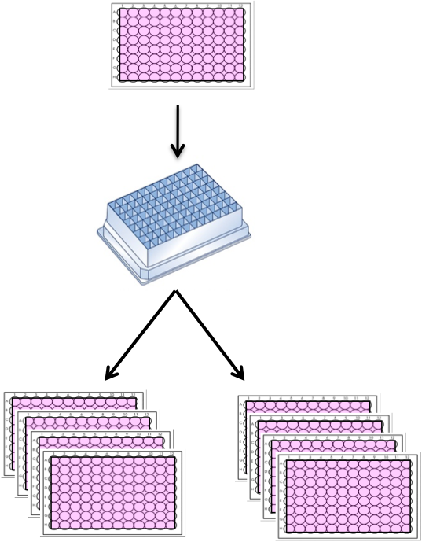
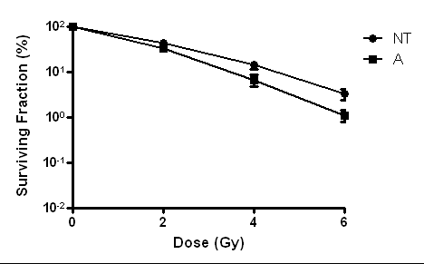
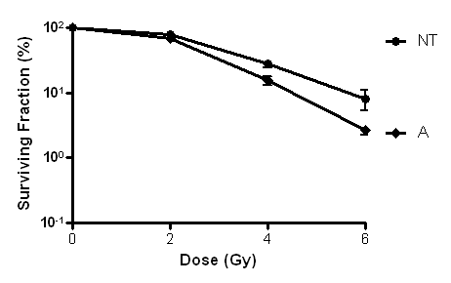
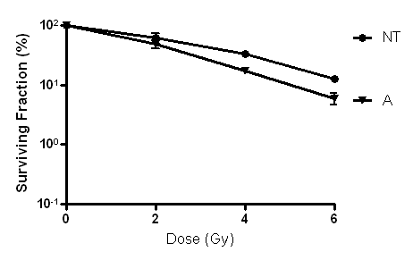
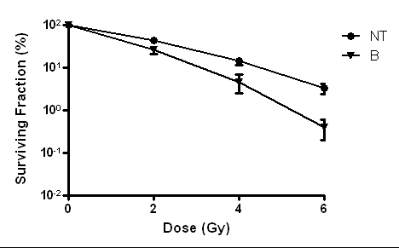
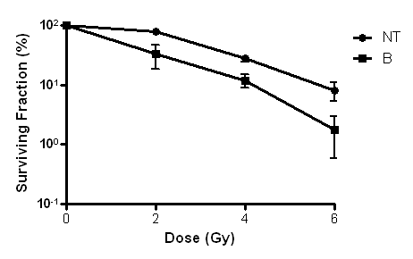
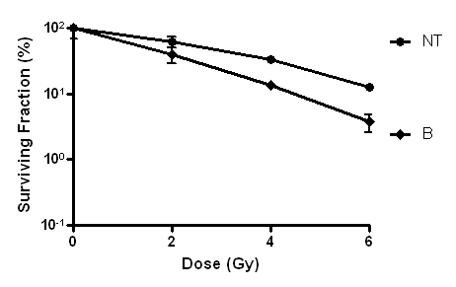



Discovery and investigation of novel radiosensitising genes
Gaganpreet Tiwana¹, Remko Prevo¹, Balam Budwal¹ ,Daniel Ebner², Alison Howarth², Kwun-Ye Chu¹, Lisa Durrant¹, Gillies McKenna¹, Geoffrey Higgins¹
¹ Gray Institute for Radiation Oncology and Biology, Oxford, UK ² Target Discovery Institute, Oxford, UK
Introduction
Conclusions
Radiotherapy treatment is a balance between tumour control and normal tissue complication probabilities
Widening this treatment window can be achieved by modulating intrinsic radiosensitivity of tumour cells
Key determinants of intrinsic radiosensitivity remain largely unknown
Novel determinants of radiosensitivity can be identified through high-throughput siRNA screening employing a relevant radiation endpoint. Colony formation is the gold standard in assessing the replicative potential of a tumour cell following radiation treatment.
‘Aim of this study is to identify novel radiosensitising genes using high throughput clonogenic survival siRNA screens’
We have successfully developed and implemented a high throughput 96-well colony formation screen to identify novel radiosensitising genes.
The screen has identified seven possible novel radiosensitisers in the kinome siRNA library.
The druggable siRNA library screen has been concluded, yielding a Z-factor of 0.49. Validation of novel radiosensitising genes is underway.
This screen setup will also be used to screen compound libraries to identify novel radiosensitising drugs.
Kinome siRNA survival screen results
Kinome siRNA library consisting of 709 genes was screened using the 96-well plate colony formation assay. The Z factor for the screen was 0.39.
Z scores were calculated to evaluate if target genes were radiosensitising ( Z score <0). Surviving fractions (SF) were first calculated by dividing the mean number of colonies following irradiation by the mean number of colonies in un-irradiated controls. SF of target genes were normalised to the average SF of non-targeting (NT) control siRNA wells (n=8) on each plate to take into account plate variations.
Z score= (Normalised SF- Normalised median NT SF across all plates)/(Average deviation of NT SF across all plates)
Known radiosensitising genes were identified in the screen, which included ATM, ATR, CHEK1 and DNA-PKcs (Figure 2A).
Seven possible novel radiosensitising genes have been identified and are being investigated in 6-well colony formation assays using siRNA from a different vendor to confirm the absence of off-target effects. Genes A and B are shown as examples of genes providing tumour specific radiosensitisation in HeLa, PSN1 and SQ20B cell lines. (Figure 2B)
Experimental procedure
Kinome and Druggable genome (Dharmacon ON-TARGETplus) siRNA library screens were conducted in HeLa cells quantifying colony formation following irradiation(IR) as an endpoint.
The kinome and druggable libraries consisted of a combined total 128 plates (96-well), run in separate batches.
96-well experimental plates containing target siRNA were transfected on day 1 at a concentration of 20nM using DharmaFECT1 transfection reagent.
72hrs post transfection, cells were lifted and plated into two sets of quadruplicate repeat 96-well plates. Plates were left to adhere for 4hrs.
Treatment plates were irradiated at 7 Gy using 6MV X-ray photons delivered by Varian Clinac iX Linear accelerator.
Plates were incubated for 7-9 days and stained with crystal violet. Colonies were counted and Z-scores calculated.
A
Day 1 transfection
Gene A
Gene B
ATR
Day 4 plating and irradiation
ATM
X-Rays
B
HeLa
PSN1
PRKDC/ DNA-PKcs
SQ20B
0 Gy
7 Gy
7-9 days incubation
Figure 2 A. Z-score diagram of the Kinome library screen highlighting known radiosensitivity determinants that were identified as hits. The identification of ATM, ATR,CHEK1, PRKDC (DNA-PKcs) among the top genes whose depletion caused reduced radiosurvival is proof of principal for the screening assay.
B. Tumour specific radiosensitisation caused by siRNA depletion of Gene A & B. 6-well colony formation assay carried out with 20nM target siRNA (Ambion ON-TARGETplus ) in HeLa, PSN1 and SQ20B cancer cell lines.
Staining
Figure 1 Schematic diagram of the screen procedure of one library plate. HeLa cells were transfected by reverse transfection on day 1 and on day 4 lifted in trypsin, transferred to a 96 deepwell plate, from which approximately 190 cells/well were transferred to the 0Gy plates and 1600 cells/well to the 7Gy plates. Colonies on the 96-well plates were stained with crystal violet stain and quantitated one week later. Colonies were counted using the GelCount colony counter (Oxford Optronix).
Acknowledgements
This work was supported by Medical Research Council, Cancer Research UK and NIHR biomedical research centre, Oxford.
Contact : gagan.tiwana@oncology.ox.ac.uk

